Slide 1

Post-Build Considerations
HTML & CSS

Slide 2

What is “post-build”?
When developing a website / web application, we typically develop the site in “development”
Means the version we are working on is private
Our code is not publicly available or open on a webhost
Ensures any errors occur in a controlled environment
We can focus solely on required features
When we finish this initial build, our job is NOT done
We now need to test & enhance this build before making it ready for “production”

Slide 3

Post-build step prior to launch
Once we have built all required features – we want to ensure the site works consistently before launching:
This post-build process (alpha & beta) will test the source code against several metrics & tools
We need to ensure we “take a breath” before we migrate the application to a live environment
We want to remove errors, inconsistencies and buggy features before the end-user sees them!

Slide 4
Standards & Guidelines

Slide 5

Web standards (recap)
HTML – HyperText Markup language
Used to structure web pages using its’ tag-element system
Group managing the standard: WHATWG
CSS – Cascading Stylesheet language
Used to design the presentation/layout of a markup web document
Group managing the standard: W3C
HTTP/S – Hypertext Transfer Protocol
Foundation communication protocol for the modern web, using a system of requests & responses
The added “s” to HTTPS, is the secure version of HTTP which uses encryption to secure the communication over the web

Slide 6

Accessibility Guidelines (recap)
WCAG – Web Content Accessibility Guidelines
Core guideline defining how to broadly make web content more accessible to people with disabilities or disadvantaged access
WAI-ARIA - Accessible Rich Internet Applications Suite
Guidelines/technologies to make “unsemantic” HTML more readable to browsers & assistive tools, like screen readers
UAAG - User Agent Accessibility Guidelines
Guidelines explaining how to make “user agents” accessible, which includes browsers, browser extensions, media players & readers
ATAG - Authoring Tool Accessibility Guidelines
Guidelines to check that the web developer’s tools are also accessible and support them in authoring accessible content to the web

Slide 7
Website Testing

Slide 8

Testing websites before “production”
Once we have built all required features – we want to ensure the site works consistently before launching
This post-build process (alpha & beta) will test the source code against several metrics & tools
We need to ensure we “take a breath” before we migrate the application to a live environment
We want to remove errors, inconsistencies and buggy features before the end-user sees them!
Whilst our sites our relatively small, once we start building bigger sites, post-build processes can get pretty complex …

Slide 9
How complex can testing get?
Beta testing
Mobile-friendly testing
Change related testing
Security testing
Performance testing
Documentation testing
Functional testing
Usability testing
UI testing
Compatibility (Configuration) testing

Slide 10
Our focus
Beta testing
Mobile-friendly testing
Change related testing
Security testing
Performance testing
Documentation testing
Functional testing
Usability testing
UI testing
Compatibility (Configuration) testing

Slide 11
Accessibility Testing
HTML & CSS

Slide 12

Purpose of accessibility (recap)
According to WCAG, accessible sites should enshrine four key principles:
Perceivable
Operable
Understandable
Robust
These are actually quite hard to measure against, so WCAG created compliance “levels” to meet, depending on your audience:
“A” Essential
“AA” Ideal Support
“AAA” Specialised Support

Slide 13

User Groups & Targeting your User(s)
In order to know how strict we should adhere to accessibility, we therefore need to know our anticipated users:
This is also extremely important when building websites in general, as we generally design the site to meet their demands
Assessment – you are required to identify two types of users who will visit your site that have accessibility issues:
Examples: Color-blind user OR poor eyesight user OR mobile users
If your expected user base included these users, you would likely need to meet at least WCAG “AA Ideal Support” Level

Slide 14

Usability / Accessibility Checklist
Normally, during post-build, developers will prepare a “useability checklist” ahead of launching – to ensure that all essential user concerns are met, including:
Accessibility
Navigation
Content
Identity
There is an example of a basic useability checklist on Brightspace
Assessment – you are required to make a more specific “accessibility checklist”, which is often within a useability checklist
Only need to provide three things to cover, to ensure you help your identified accessibility users
Example of large accessibility checklist
A2 Example: “Make sure all img elements have an alt attribute”

Slide 15

Fundamental Accessibility Rules
Whilst there are many considerations regarding accessibility, there are generally a few core rules you must observe every build & include:
Images must include descriptive “alt” tags
Form inputs must include descriptive labels
Websites must still be readable without CSS
Anchor links should use descriptive text
HTML heading & grouping tag rules should be followed (i.e. 1 <main> per page)
HTML semantics should be observed

Slide 16

Accessibility Testing Tools
We will test for different aspects that help a developer to ascribe to core accessibility guidelines
Monochrome/non-CSS readability
Ensure webpage can be displayed without any stylesheet
Tool: Disable CSS stylesheet either in code editor or Network tab in Browser dev tools
Colour contrast
Ensure webpage can be read without colours (as greyscale)
Tool: Adobe Color Analyzer / DevTools plugin
Text equivalents / screen readability
Ensure non-text elements have a text equivalent, so can be read by screen readers
Tool: Read Aloud Chrome Extension
Recommended HTML semantics
Ensure HTML is written correctly & uses elements which accurately describe the content
Tool: Browser DevTools / HTML Validator (later)

Slide 17
Functionality Testing
HTML & CSS

Slide 18

Website Functionality
Website functionality testing, tests UI/features for bugs and errors
“Functionality testing” can be a wide field and can include checking user usability, compatibility between devices & browsers, security testing and dynamic UI testing
Example: Test that the contact form correctly submits user information to the server-side API
Functionality testing becomes more complex and time-consuming, the more technical the site is
In our case, HTML/CSS 3-page static websites have only a few items worthy of functionality testing

Slide 19

Functionality Testing Tools
We will use a few key aspects to focus on regarding functionality
Browser accessibility
Confirming website / app works consistently between different browsers, by opening up on a sample set of browsers
Markup validation
Validation of markup via W3C validation service against standard: validator
Stylesheet validation
Validation of stylesheet by W3C validation service against standard: validator
Manual feature testing
Testing checklist on specific features to ensure they work as expected (checking against actual output)

Slide 20
Performance Testing
HTML & CSS

Slide 21

Website “Technical” Performance
Testing websites does NOT only focus on bugs and errors – but can look at the wider performance of the site when a user accesses it
Technical performance measurement checks the overall speed and efficiency of a website, and will track items like:
load times
efficiency of loading certain assets
efficacy of scripts running on the page
SEO and search metrics
user access and conversion metrics

Slide 22
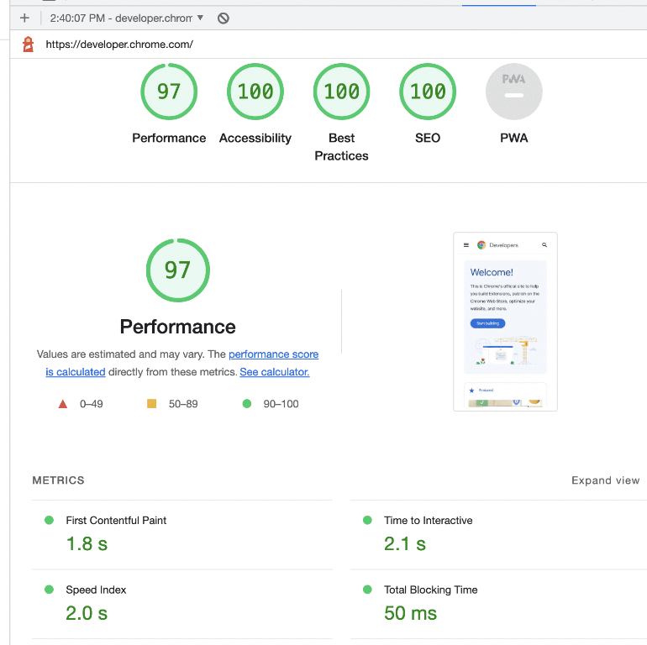
Performance Testing Tools
We will use one major tool for performance, as HTML/CSS websites by nature should be fast:
Google Lighthouse testing
This tool, built into your browser, includes SEVERAL important tools beyond performance too
You can even test accessibility!

